Slide 1

21AI52-Artificial Intelligence and Machine Learning
RV College of
Engineering
Go, change the world
Unit-IV

Slide 2
Contents
Nearest Neighbor Classifiers
Naive Bayes Classifier
Logistic Regression
Ensemble Methods

Slide 3
Nearest Neighbor Classifiers
Basic idea:
If it walks like a duck, quacks like a duck, then it’s probably a duck
Compute Distance
Test Record
Training Records
Choose k of the “nearest” records

Slide 4
Nearest Neighbor Classifiers
Find all the training examples that are relatively similar to the attributes of the test example
These examples, which are known as nearest neighbors, can be used to determine the class label of the test example
Nearestneighbor classifier represents each example as a data point in a d-dimensionalspace, where d is the number of attributes
Given a test example, its proximity to the rest of the data points in the training set is computed, using one ofthe proximity measures
The k-nearest neighbors of a given example z refer to the k points that are closest to z.

Slide 5
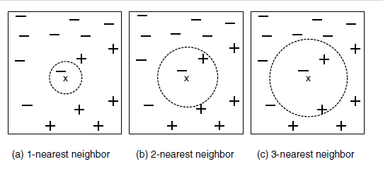
Nearest Neighbor Classifiers
Fig illustrtaes 1-, 2-, and 3-nearest neighbors of a data point located at the center of each circle
Data point is classified based on the class labels of its neighbors
In the case where the neighbors have more than one label, the data point is assigned to the majority class of its nearestneighbors

Slide 6
Nearest-Neighbor Classifiers
Requires the following:
A set of labeled records
Proximity metric to compute distance/similarity between a pair of records
e.g., Euclidean distance
The value of k, the number of nearest neighbors to retrieve
A method for using class labels of K nearest neighbors to determine the class label of unknown record (e.g., by taking majority vote)

Slide 7
Choice of proximity measure matters
For documents, cosine is better than correlation or Euclidean
1 1 1 1 1 1 1 1 1 1 1 0
0 0 0 0 0 0 0 0 0 0 0 1
vs
0 1 1 1 1 1 1 1 1 1 1 1
1 0 0 0 0 0 0 0 0 0 0 0
Euclidean distance = 1.4142 for both pairs, but the cosine similarity measure has different values for these pairs.

Slide 8
Nearest Neighbor Classification…
Choosing the value of k:
If k is too small, then the nearest-neighbor classifier may be susceptible to overfitting because of noise in the training data
On the other hand, if k is too large, the nearest-neighbor classifier may misclassify the test instance because its list of nearest neighbors may include data points that are located far away from its neighborhood

Slide 9
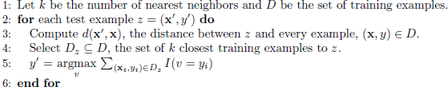
Nearest Neighbor Classification…
Algorithm:
Algorithm computes the distance (or similarity) between
each test example z = (x, y) and all the training examples (x, y) ∈ D to determine its nearest-neighbor list, Dz
Such computation can be costly if the number of training examples is large. However, efficient indexing techniques are available to reduce the amount of computations needed to find the nearest neighbors of a test example.

Slide 10
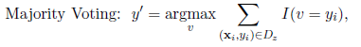
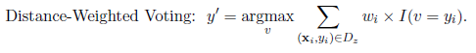
Nearest Neighbor Classification…
Majority Voting
In the majority voting approach, every neighbor has the same impact on the classification
This makes the algorithm sensitive to the choice of k
Distance-Weighted Voting
One way to reduce the impact of k is to weight the influence of each nearest neighbor x_{i} according to its distance: w_{i} =
As a result, training examples that are located far away from z have a weaker impact on the classification compared to those that are located close to z.

Slide 11
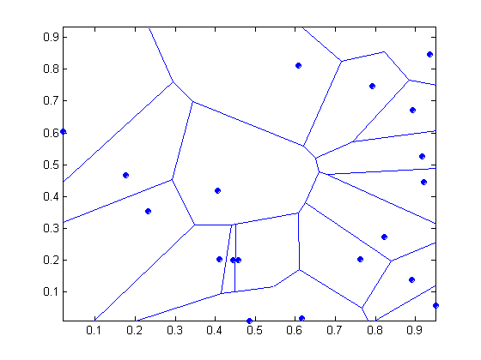
Nearest-neighbor classifiers
Nearest neighbor classifiers are local classifiers
They can produce decision boundaries of arbitrary shapes.

Slide 12
Characteristics of Nearest-Neighbor Classifiers
Nearest-neighbor classification is part of a more general technique known as instance-based learning, which uses specific training instances to make predictions without having to maintain an abstraction (or model) derived from data. Instance-based learning algorithms require a proximity measure to determine the similarity or distance between instances and a classification function that returns the predicted class of a test instance based on its proximity to other instances.
Lazy learners such as nearest-neighbor classifiers do not require model building. However, classifying a test example can be quite expensive because we need to compute the proximity values individually between the test and training examples. In contrast, eager learners often spend the bulk of their computing resources for model building. Once a model has been built, classifying a test example is extremely fast

Slide 13
Nearest-neighbor classifiers make their predictions based on local information, whereas decision tree and rule-based classifiers attempt to find a global model that fits the entire input space. Because the classification decisions are made locally, nearest-neighbor classifiers (with small values of k) are quite susceptible to noise.
Nearest-neighbor classifiers can produce arbitrarily shaped decision boundaries. Such boundaries provide a more flexible model representation compared to decision tree and rule-based classifiers that are often constrained to rectilinear decision boundaries.
Nearest-neighbor classifiers can produce wrong predictions unless the appropriate proximity measure and data preprocessing steps are taken. For example, suppose we want to classify a group of people based on attributes such as height (measured in meters) and weight (measured in pounds). The height attribute has a low variability, ranging from 1.5 m to 1.85 m, whereas the weight attribute may vary from 90 lb. to 250 lb. If the scale of the attributes are not taken into consideration, the proximity measure may be dominated by differences in the weights of a person.

Slide 14
Nearest Neighbor Classification…
How to handle missing values in training and test sets?
Proximity computations normally require the presence of all attributes
Some approaches use the subset of attributes present in two instances
This may not produce good results since it effectively uses different proximity measures for each pair of instances
Thus, proximities are not comparable

Slide 15
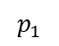
Naive Bayes Classifier
$$p_{1}$$

Slide 16
Bayes Classifier
In many applications the relationship between the attribute set and the class variable is non-deterministic.
In other words, the class label of a test record cannot be predicted with certainty even though its attribute set is identical to some of the training examples.
This situation may arise because of noisy data that affect classification but are not included in the analysis.
For example, consider the task of predicting whether a person is at risk for heart disease based on the person’s diet and workout frequency.
Although most people who eat healthily and exercise regularly have less chance of developing heart disease, they may still do so because of other factors such as heredity, excessive smoking, and alcohol abuse.
This introduce uncertainties into the learning problem.

Slide 17
Bayes Classifier
Consider a football game between two rival teams: Team 0 and Team 1. Suppose Team 0 wins 65% of the time and Team 1 wins the remaining matches. Among the games won by Team 0, only 30% of them come from playing on Team 1’s football field. On the other hand, 75% of the victories for Team 1 are obtained while playing at home. If Team 1 is to host the next match between the two teams, which team will most likely emerge as the winner?
This question can be answered by using the well-known Bayes theorem.

Slide 18
Bayes Classifier
Let X and Y be a pair of random variables. Their joint probability, P(X = x, Y = y), refers to the probability that variable X will take on the value x and variable Y will take on the value y.
A conditional probability is the probability that a random variable will take on a particular value given that the outcome for another random variable is known.
For example, the conditional probability P(Y = y|X = x) refers to the probability that the variable Y will take on the value y, given that the variable X is observed to have the value x.

Slide 19
Bayes Classifier
A probabilistic framework for solving classification problems
Conditional Probability:
The joint and conditional probabilities for X and Y are related in the following way:
P(X, Y ) = P(Y |X) × P(X) = P(X|Y ) × P(Y ).

Slide 20
Bayes Classifier
Conditional Probability:
Bayes theorem:

Slide 21
Bayes Classifier
The Bayes theorem can be used to solve the prediction problem stated below
Consider a football game between two rival teams: Team 0 and Team 1. Suppose Team 0 wins 65% of the time and Team 1 wins the remaining matches. Among the games won by Team 0, only 30% of them come from playing on Team 1’s football field. On the other hand, 75% of the victories for Team 1 are obtained while playing at home. If Team 1 is to host the next match between the two teams, which team will most likely emerge as the winner?
For notational convenience, let X be the random variable that represents the team hosting the match and Y be the random variable that represents the winner of the match. Both X and Y can take on values from the set {0, 1}.
information given in the problem as follows:
Probability Team 0 wins is P(Y = 0) = 0.65.
Probability Team 1 wins is P(Y = 1) = 1 − P(Y = 0) = 0.35.
Probability Team 1 hosted the match it won is P(X = 1|Y = 1) = 0.75.
Probability Team 1 hosted the match won by Team 0 is P(X = 1|Y = 0) = 0.3.

Slide 22
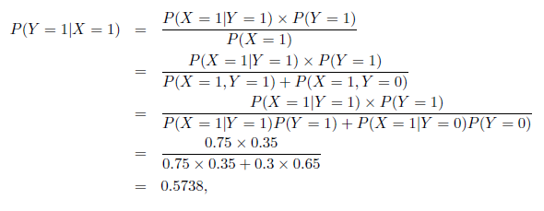
Bayes Classifier
Probability Team 0 wins is P(Y = 0) = 0.65.
Probability Team 1 wins is P(Y = 1) = 1 − P(Y = 0) = 0.35.
Probability Team 1 hosted the match it won is P(X = 1|Y = 1) = 0.75.
Probability Team 1 hosted the match won by Team 0 is P(X = 1|Y = 0) = 0.3
Our objective is to compute P(Y = 1|X = 1), which is the conditional probability that Team 1 wins the next match it will be hosting, and compares it against P(Y = 0|X = 1). Using the Bayes theorem,

Slide 23
Using Bayes Theorem for Classification
Class variable has a non-deterministic relationship with the attributes, then we can treat X and Y as random variables and capture their relationship probabilistically using P(Y |X).
This conditional probability is also known as the posterior probability for Y , as opposed to its prior probability, P(Y ).
Consider each attribute and class label as random variables
Given a record with attributes (X₁, X₂,…, X_{d}), the goal is to predict class Y
Specifically, we want to find the value of Y that maximizes P(Y| X₁, X₂,…, X_{d} )
Can we estimate P(Y| X₁, X₂,…, X_{d} ) directly from data?

Slide 24
Using Bayes Theorem for Classification
During the training phase, we need to learn the posterior probabilities P(Y |X) for every combination of X and Y based on information gathered from the training data
By knowing these probabilities, a test record X can be classified by finding the class Y that maximizes the posterior probability P(Y |X).

Slide 25
Using Bayes Theorem for Classification
Approach:
compute posterior probability P(Y | X₁, X₂, …, X_{d}) using the Bayes theorem
Maximum a-posteriori: Choose Y that maximizes P(Y | X₁, X₂, …, X_{d})
Equivalent to choosing value of Y that maximizes P(X₁, X₂, …, X_{d}|Y) P(Y)
How to estimate P(X₁, X₂, …, X_{d} | Y )?

Slide 26
Example Data
Given a Test Record:
We need to estimate
P(Evade = Yes | X) and P(Evade = No | X)
In the following we will replace
Evade = Yes by Yes, and
Evade = No by No

Slide 27
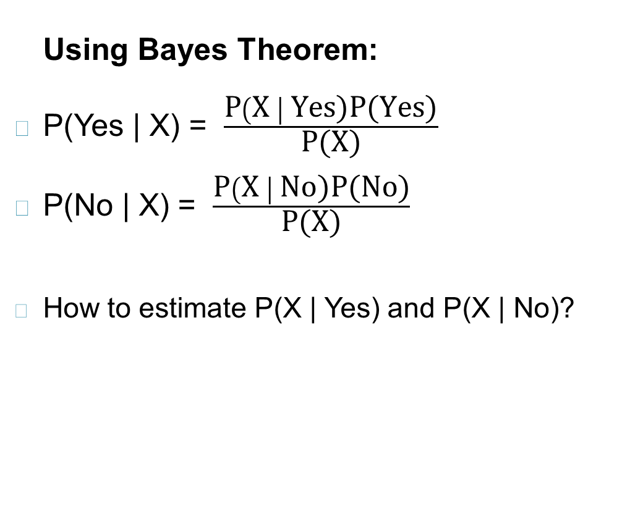
Example Data
Given a Test Record:

Slide 28
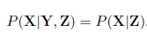
Conditional Independence
X and Y are conditionally independent given Z if P(X|YZ) = P(X|Z)
Example: Arm length and reading skills
Young child has shorter arm length and limited reading skills, compared to adults
If age is fixed, no apparent relationship between arm length and reading skills
Arm length and reading skills are conditionally independent given age

Slide 29
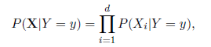
Naïve Bayes Classifier
A na¨ıve Bayes classifier estimates the class-conditional probability by assuming that the attributes are conditionally independent, given the class label y.
Conditional independence assumption can be formally stated as follows:
where each attribute set X = {X₁,X₂, . . . , X_{d}} consists of d attributes

Slide 30
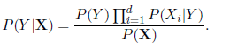
Naïve Bayes Classifier
Assume independence among attributes X_{i} when class is given:
P(X₁, X₂, …, X_{d} |Y_{j}) = P(X₁| Y_{j}) P(X₂| Y_{j})… P(X_{d}| Y_{j})
Now we can estimate P(X_{i}| Y_{j}) for all X_{i} and Y_{j} combinations from the training data
To classify a test record, the na¨ıve Bayes classifier computes the posterior probability for each class Y :
New point is classified to Y_{j} if P(Y_{j}) Π P(X_{i}| Y_{j}) is maximal.

Slide 31
Naïve Bayes on Example Data
Given a Test Record:
P(X | Yes) =
P(Refund = No | Yes) x
P(Divorced | Yes) x
P(Income = 120K | Yes)
P(X | No) =
P(Refund = No | No) x
P(Divorced | No) x
P(Income = 120K | No)

Slide 32
Estimate Probabilities for Categorical Attributes
P(y) = fraction of instances of class y
e.g., P(No) = 7/10, P(Yes) = 3/10
For categorical attributes: P(X_{i} =c| y) = n_{c}/ n
where |X_{i} =c| is number of instances having attribute value X_{i} =c and belonging to class y
Examples:
P(Status=Married|No) = 4/7 P(Refund=Yes|Yes)=0

Slide 33
Estimate Probabilities continuous attributes
Discretization: Partition the range into bins:
Replace continuous value with bin value
Attribute changed from continuous to ordinal
Probability density estimation:
Assume attribute follows a normal distribution
Use data to estimate parameters of distribution (e.g., mean and standard deviation)
Once probability distribution is known, use it to estimate the conditional probability P(X_{i}|Y)

Slide 34
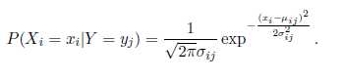
Estimate Probabilities continuous attributes
Normal distribution:
One for each (X_{i},Y_{i}) pair
The distribution is characterized by two parameters, its mean, μ, and variance, σ².
For (Income, Class=No):
If Class=No
sample mean = 110
sample variance = 2975

Slide 35
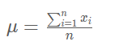
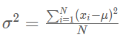
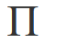
Estimate Probabilities for Categorical Attributes
mean of a population is
population variance is
3.14159265359
e( mathematical constant)
2.7182

Slide 36
Example of Naïve Bayes Classifier
Given a Test Record:
Naïve Bayes Classifier:
P(Refund = Yes | No) = 3/7
P(Refund = No | No) = 4/7
P(Refund = Yes | Yes) = 0
P(Refund = No | Yes) = 1
P(Marital Status = Single | No) = 2/7
P(Marital Status = Divorced | No) = 1/7
P(Marital Status = Married | No) = 4/7
P(Marital Status = Single | Yes) = 2/3
P(Marital Status = Divorced | Yes) = 1/3
P(Marital Status = Married | Yes) = 0
For Taxable Income:
If class = No: sample mean = 110
sample variance = 2975
If class = Yes: sample mean = 90
sample variance = 25
P(X | No) = P(Refund=No | No) × P(Divorced | No) × P(Income=120K | No) = 4/7 × 1/7 × 0.0072 = 0.0006
P(X | Yes) = P(Refund=No | Yes) × P(Divorced | Yes) × P(Income=120K | Yes) = 1 × 1/3 × 1.2 × 10⁻⁹ = 4 × 10⁻¹⁰
Since P(X|No)P(No) > P(X|Yes)P(Yes)
Therefore P(No|X) > P(Yes|X) => Class = No

Slide 37
Example of Naïve Bayes Classifier
Given a Test Record:
Naïve Bayes Classifier:
P(Refund = Yes | No) = 3/7
P(Refund = No | No) = 4/7
P(Refund = Yes | Yes) = 0
P(Refund = No | Yes) = 1
P(Marital Status = Single | No) = 2/7
P(Marital Status = Divorced | No) = 1/7
P(Marital Status = Married | No) = 4/7
P(Marital Status = Single | Yes) = 2/3
P(Marital Status = Divorced | Yes) = 1/3
P(Marital Status = Married | Yes) = 0
For Taxable Income:
If class = No: sample mean = 110
sample variance = 2975
If class = Yes: sample mean = 90
sample variance = 25

Slide 38
Naïve Bayes Classifier can make decisions with partial information about attributes in the test record
Even in absence of information about any attributes, we can use Apriori Probabilities of Class Variable:
P(Yes) = 3/10
P(No) = 7/10
If we only know that marital status is Divorced, then:
P(Yes | Divorced) = 1/3 x 3/10 / P(Divorced)
P(No | Divorced) = 1/7 x 7/10 / P(Divorced)
If we also know that Refund = No, then
P(Yes | Refund = No, Divorced) = 1 x 1/3 x 3/10 / P(Divorced, Refund = No)
P(No | Refund = No, Divorced) = 4/7 x 1/7 x 7/10 / P(Divorced, Refund = No)
If we also know that Taxable Income = 120, then
P(Yes | Refund = No, Divorced, Income = 120) = 1.2 x10⁻⁹ x 1 x 1/3 x 3/10 / P(Divorced, Refund = No, Income = 120 )
P(No | Refund = No, Divorced Income = 120) = 0.0072 x 4/7 x 1/7 x 7/10 / P(Divorced, Refund = No, Income = 120)
Naïve Bayes Classifier:
P(Refund = Yes | No) = 3/7
P(Refund = No | No) = 4/7
P(Refund = Yes | Yes) = 0
P(Refund = No | Yes) = 1
P(Marital Status = Single | No) = 2/7
P(Marital Status = Divorced | No) = 1/7
P(Marital Status = Married | No) = 4/7
P(Marital Status = Single | Yes) = 2/3
P(Marital Status = Divorced | Yes) = 1/3
P(Marital Status = Married | Yes) = 0
For Taxable Income:
If class = No: sample mean = 110
sample variance = 2975
If class = Yes: sample mean = 90
sample variance = 25

Slide 39
Issues with Naïve Bayes Classifier
Given a Test Record:
X = (Married)
Naïve Bayes Classifier:
P(Refund = Yes | No) = 3/7
P(Refund = No | No) = 4/7
P(Refund = Yes | Yes) = 0
P(Refund = No | Yes) = 1
P(Marital Status = Single | No) = 2/7
P(Marital Status = Divorced | No) = 1/7
P(Marital Status = Married | No) = 4/7
P(Marital Status = Single | Yes) = 2/3
P(Marital Status = Divorced | Yes) = 1/3
P(Marital Status = Married | Yes) = 0
For Taxable Income:
If class = No: sample mean = 110
sample variance = 2975
If class = Yes: sample mean = 90
sample variance = 25
P(Yes) = 3/10
P(No) = 7/10
P(Yes | Married) = 0 x 3/10 / P(Married)
P(No | Married) = 4/7 x 7/10 / P(Married)

Slide 40
Issues with Naïve Bayes Classifier
Consider the table with Tid = 7 deleted
Naïve Bayes Classifier:
P(Refund = Yes | No) = 2/6
P(Refund = No | No) = 4/6
P(Refund = Yes | Yes) = 0
P(Refund = No | Yes) = 1
P(Marital Status = Single | No) = 2/6
P(Marital Status = Divorced | No) = 0
P(Marital Status = Married | No) = 4/6
P(Marital Status = Single | Yes) = 2/3
P(Marital Status = Divorced | Yes) = 1/3
P(Marital Status = Married | Yes) = 0/3
For Taxable Income:
If class = No: sample mean = 91
sample variance = 685
If class = No: sample mean = 90
sample variance = 25
Given X = (Refund = Yes, Divorced, 120K)
P(X | No) = 2/6 X 0 X 0.0083 = 0
P(X | Yes) = 0 X 1/3 X 1.2 X 10⁻⁹ = 0
Naïve Bayes will not be able to classify X as Yes or No!

Slide 41
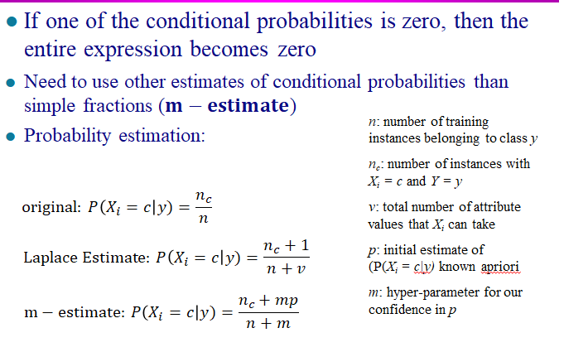
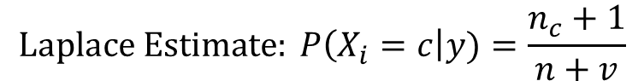
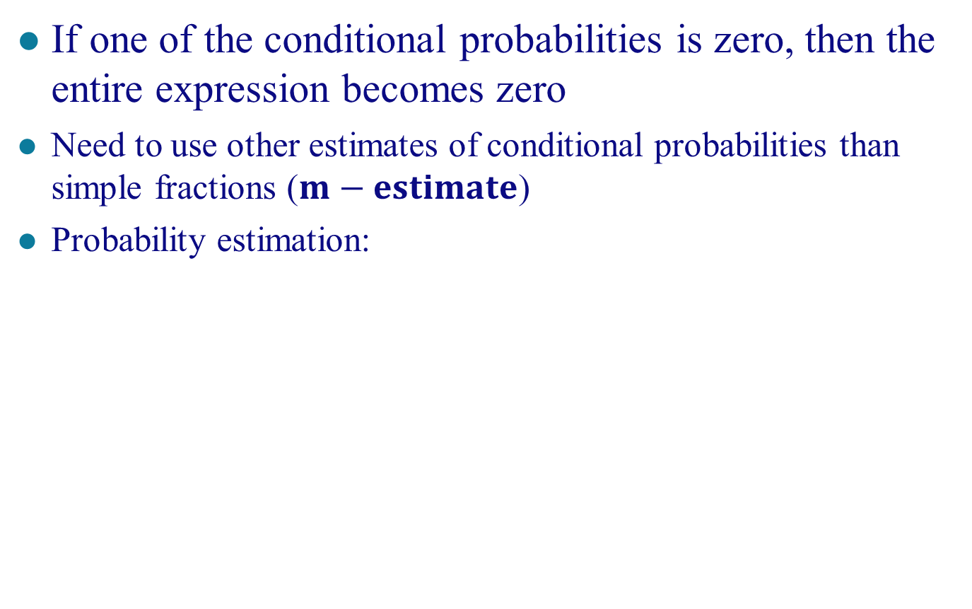
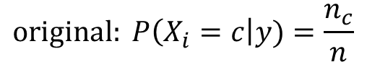
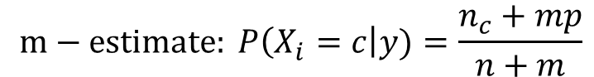
Issues with Naïve Bayes Classifier
If one of the conditional probabilities is zero, then the entire expression becomes zero
Need to use other estimates of conditional probabilities than simple fractions ($m−estimate$)
Probability estimation:
n: number of training instances belonging to class y
n_{c}: number of instances with X_{i} = c and Y = y
v: total number of attribute values that X_{i} can take
p: initial estimate of (P(X_{i} = c|y) known apriori
m: hyper-parameter for our confidence in p
$$original: P\left(X_{i}=c\right|y)=\frac{n_{c}}{n}$$
$$Laplace Estimate: P\left(X_{i}=c\right|y)=\frac{n_{c}+1}{n+v}$$
$$m−estimate: P\left(X_{i}=c\right|y)=\frac{n_{c}+mp}{n+m}$$

Slide 42
Example of Naïve Bayes Classifier
A: attributes
M: mammals
N: non-mammals

Slide 43
Example of Naïve Bayes Classifier
A: attributes
M: mammals
N: non-mammals
P(A|M)P(M) > P(A|N)P(N)
=> Mammals

Slide 44
Naïve Bayes (Summary)
Robust to isolated noise points
Handle missing values by ignoring the instance during probability estimate calculations
Robust to irrelevant attributes
Redundant and correlated attributes will violate class conditional assumption
Use other techniques such as Bayesian Belief Networks (BBN)

Slide 45
Naïve Bayes (Summary)
They are robust to isolated noise points because such points are averaged out when estimating conditional probabilities from data. Na¨ıve Bayes classifiers can also handle missing values by ignoring the example during model building and classification.
They are robust to irrelevant attributes. If Xi is an irrelevant attribute, then P(Xi|Y ) becomes almost uniformly distributed. The class conditional probability for Xi has no impact on the overall computation of the posterior probability.

Slide 46
Naïve Bayes (Summary)
Correlated attributes can degrade the performance of na¨ıve Bayes classifiers because the conditional independence assumption no longer holds for such attributes.
Use other techniques such as Bayesian Belief Networks (BBN)

Slide 47
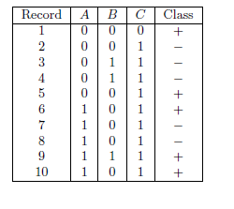
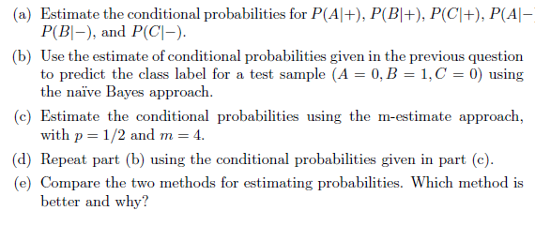
Bayes Classifier

Slide 48
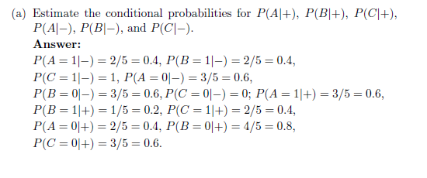
Bayes Classifier

Slide 49
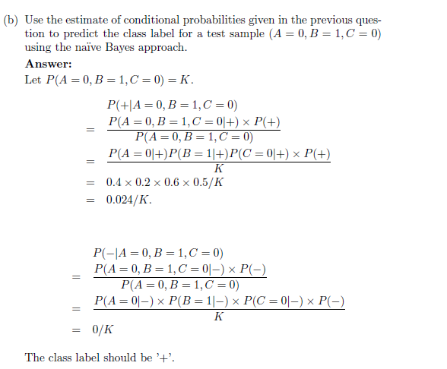
Bayes Classifier

Slide 50
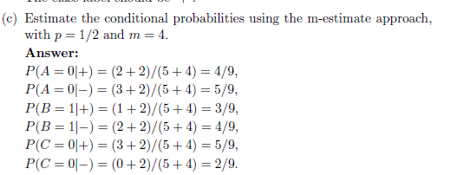
Bayes Classifier

Slide 51
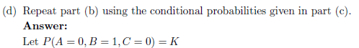
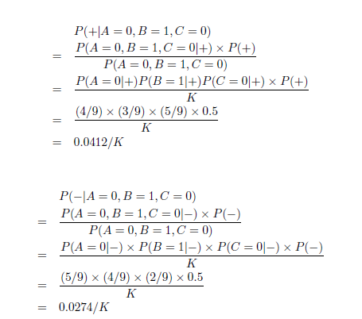
Bayes Classifier

Slide 52
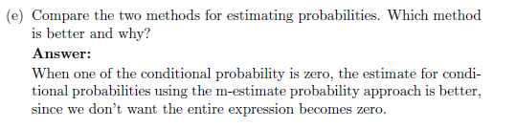
Bayes Classifier

Slide 53
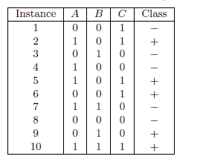
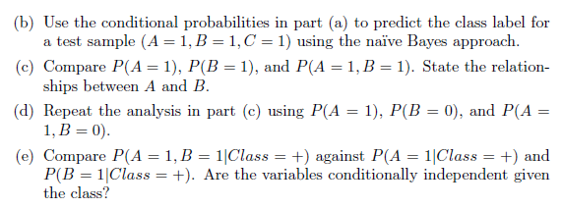
Bayes Classifier
(a) Estimate the conditional probabilities for P(A = 1|+), P(B = 1|+), P(C = 1|+), P(A = 1|−), P(B = 1|−), and P(C = 1|−)

Slide 54
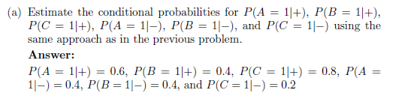
Bayes Classifier

Slide 55
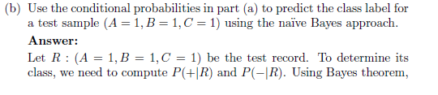
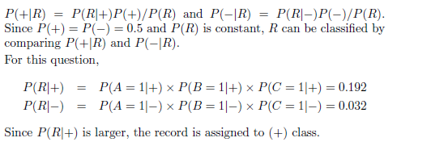
Bayes Classifier

Slide 56
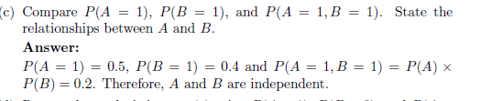
Bayes Classifier

Slide 57
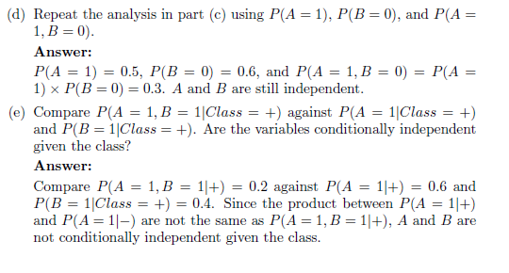
Bayes Classifier

Slide 58
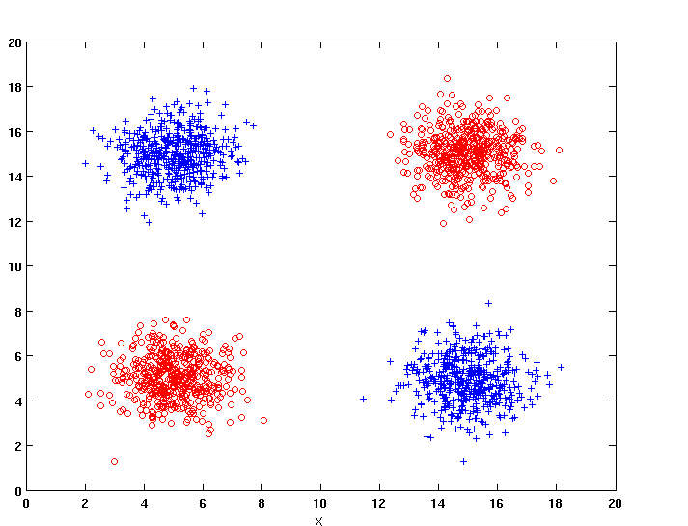
Naïve Bayes
How does Naïve Bayes perform on the following dataset?
Conditional independence of attributes is violated

Slide 59
Bayesian Belief Networks
Provides graphical representation of probabilistic relationships among a set of random variables
Consists of:
A directed acyclic graph (dag) : encoding the dependence relationships among a set of variables.
Node corresponds to a variable
Arc corresponds to dependence relationship between a pair of variables
A, B, and C, in which A and B are independent variables and each has a direct influence on a third variable, C.
A probability table associating each node to its immediate parent

Slide 60
Conditional Independence
If there is a directed arc from X to Y , then X is the parent of Y and Y is the child of X.
If there is a directed path in the network from X to Z, then X is an ancestor of Z, while Z is a descendant of X.
D is parent of C
A is child of C
B is descendant of D
D is ancestor of A
Both B and D are also non-descendants of A.

Slide 61
Conditional Independence
D is parent of C
A is child of C
B is descendant of D
D is ancestor of A
An important property of the Bayesian network
Property 1 (Conditional Independence).
A node in a Bayesian network is conditionally independent of all of its nondescendants, if its parents are known

Slide 62
Conditional Independence
In the first diagram A is conditionally independent of both B and D given C because the nodes for B and D are non- descendants of node A.
The conditional independence assumption made by a na¨ıve Bayes classifier can also be represented using a Bayesian network, as shown in 2nd diagram where y is the target class and {X1,X2, . . . , Xd} is the attribute set.

Slide 63
Probability Tables
Besides the conditional independence conditions imposed by the network topology, each node is also associated with a probability table.
If X does not have any parents, table contains prior probability P(X)
If X has only one parent (Y), table contains conditional probability P(X|Y)
If X has multiple parents (Y₁, Y₂,…, Y_{k}), table contains conditional probability P(X|Y₁, Y₂,…, Y_{k})

Slide 64
Example of Bayesian Belief Network

Slide 65
Bayesian Belief Networks
Each variable in the diagram is assumed to be binary-valued.
Parent nodes for heart disease (HD) correspond to risk factors that may affect the disease, such as exercise (E) and diet (D)
Child nodes for heart disease correspond to symptoms of the disease, such as chest pain (CP) and high blood pressure (BP).
The nodes associated with the risk factors contain only the prior probabilities, whereas the nodes for heart disease and its corresponding symptoms contain the conditional probabilities.
To save space, some of the probabilities can be omitted from the diagram. The omitted probabilities can be recovered by noting that P(X = x) = 1 − P(X = x) and P(X = x|Y ) = 1 − P(X = x|Y ), where x denotes the opposite outcome of x.
For example, the conditional probability
P(Heart Disease = No|Exercise = No, Diet = Healthy)
= 1− P(Heart Disease = Yes|Exercise = No, Diet = Healthy)
= 1− 0.55 = 0.45.

Slide 66
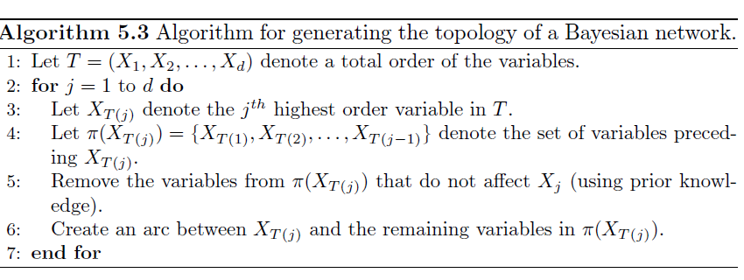
Bayesian Belief Networks :
Model Building
Model building in Bayesian networks involves two steps: (1) creating the structure of the network, and
(2) estimating the probability values in the tables associated with each node.
The network topology can be obtained by encoding the subjective knowledge of domain experts.

Slide 67
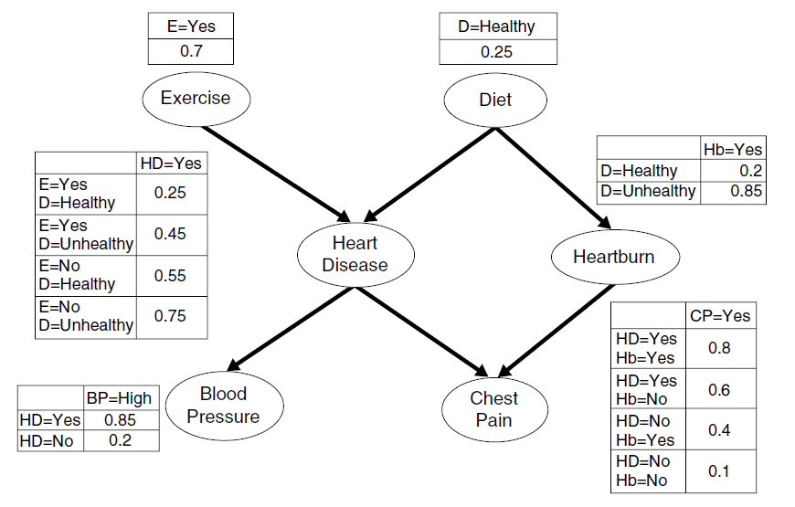
Example of Inferencing using BBN

Slide 68
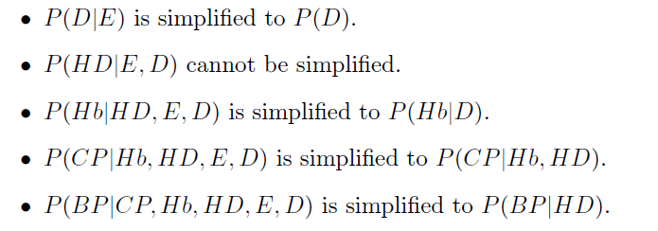
Example of Inferencing using BBN
After performing Step 1 (in previous) , let us assume that the variables are ordered in the following way: (E,D,HD,Hb, CP,BP). From Steps 2 to 7, From Steps 2 to 7, starting with variable D, we
obtain the following conditional probabilities:

Slide 69
Example of Inferencing using BBN
Based on these conditional probabilities, we can create arcs between the nodes
(E, HD), (D, HD), (D, Hb), (HD, CP), (Hb, CP), and (HD, BP).
Once the right topology has been found, the probability table associated with each node is determined. Estimating such probabilities is fairly straightforward and is similar to the approach used by na¨ıve Bayes classifiers.

Slide 70
Example of Inferencing using BBN
Algorithm for generating the topology of a Bayesian network guarantees a topology that does not contain any cycles.
The proof for this is quite straightforward. If a cycle exists, then there must be at least one arc connecting the lower-ordered nodes to the higher-ordered nodes, and at least another arc connecting the higher-ordered nodes to the lower ordered
nodes.
Since Algorithm prevents any arc from connecting the lower-ordered nodes to the higher-ordered nodes, there cannot be any cycles in the topology.

Slide 71
Example of Bayesian Belief Network

Slide 72
Example of Inferencing using BBN
Given: X = (E=No, D=Yes, CP=Yes, BP=High)
Compute P(HD|E,D,CP,BP)?
P(HD=Yes| E=No,D=Yes) = 0.55 P(CP=Yes| HD=Yes) = 0.8 P(BP=High| HD=Yes) = 0.85
P(HD=Yes|E=No,D=Yes,CP=Yes,BP=High) ∝ 0.55 × 0.8 × 0.85 = 0.374
P(HD=No| E=No,D=Yes) = 0.45 P(CP=Yes| HD=No) = 0.01 P(BP=High| HD=No) = 0.2
P(HD=No|E=No,D=Yes,CP=Yes,BP=High) ∝ 0.45 × 0.01 × 0.2 = 0.0009
Classify X as Yes

Slide 73
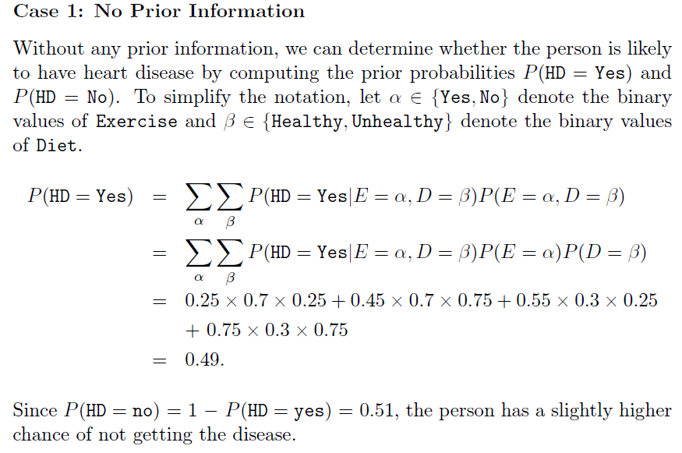
Example of Bayesian Belief Network
Suppose we are interested in using the BBN shown whether a person has heart disease. The following cases illustrate how the diagnosis can be made under different scenarios.

Slide 74
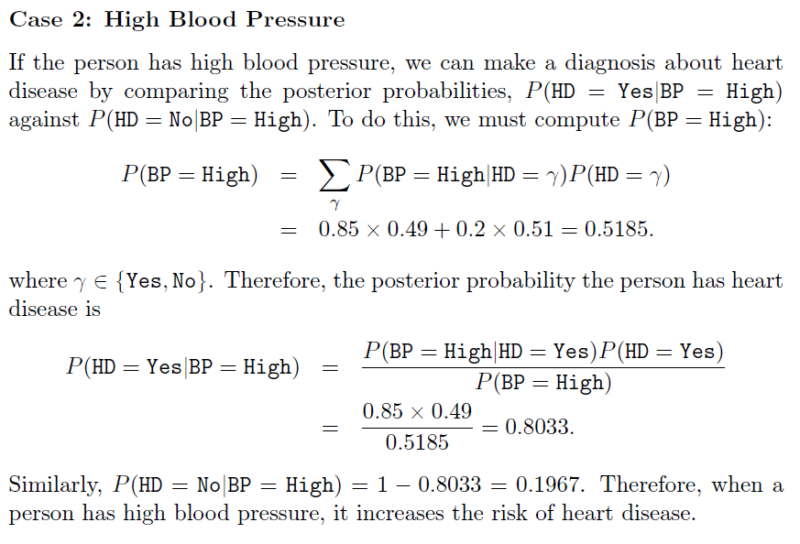
Example of Bayesian Belief Network

Slide 75
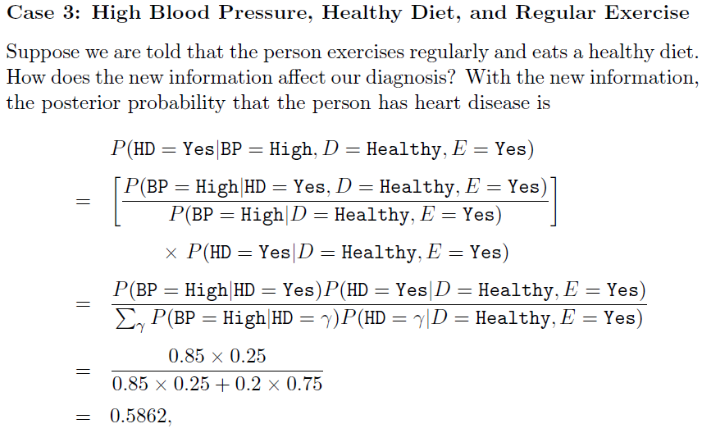
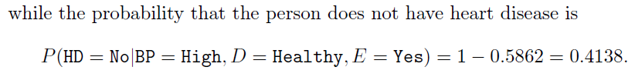
Example of Bayesian Belief Network

Slide 76
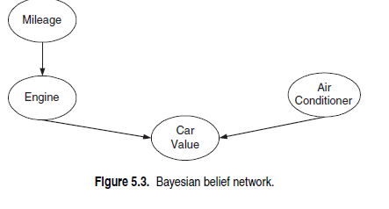
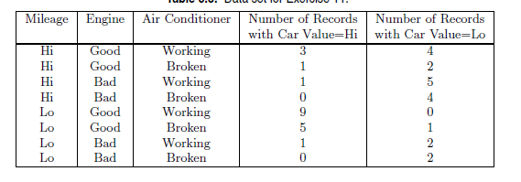
Example of Inferencing using BBN

Slide 77
Logistic Regression

Slide 78
Logistic Regression
The na¨ıve Bayes and the Bayesian network classifiers provide different ways of estimating the conditional probability of an instance x given class y, P(x|y). Such models are known as probabilistic generative models. Note that the conditional probability P(x|y) essentially describes the behavior of instances in the attribute space that are generated from class y.
For the purpose of making predictions, we are finally interested in computing the posterior probability P(y|x).

Slide 79
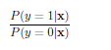
Logistic Regression
For example, computing the following ratio of posterior probabilities is sufficient for inferring class labels in a binary classification problem:
This ratio is known as the odds.
If this ratio is greater than 1, then x is classified as y = 1.
Otherwise, it is assigned to class y = 0.
One may simply learn a model of the odds based on the attribute values of training instances, without having to compute P(x|y) as an intermediate quantity in the Bayes theorem.

Slide 80
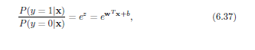
Logistic Regression
Classification models that directly assign class labels without computing class-conditional probabilities are called discriminative models.
Logistic regression is a probabilistic discriminative model ,which directly estimates the odds of a data instance x using its attribute values. The basic idea of logistic regression is to use a linear predictor, z = w^{T}x + b, for representing the odds of x as follows:
where w and b are the parameters of the model and w^{T} denotes the transpose of a vector w.
Note that if w^{T} x + b > 0, then x belongs to class 1 since its
odds is greater than 1.
Otherwise, x belongs to class 0.

Slide 81
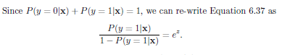
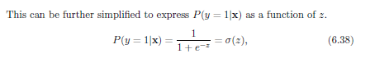
Logistic Regression
where the function σ(.) is known as the logistic or sigmoid function

Slide 82
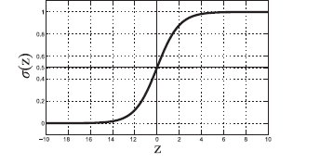

Logistic Regression
Figure below shows the behavior of the sigmoid function as we vary z. We can see that σ(z) ≥ 0.5 only when z ≥ 0.
We can also derive P(y = 0|x) using σ(z) as follows
Hence, if we have learned a suitable value of parameters w and b, we can use Equations 6.38 and 6.39 to estimate the posterior probabilities of any data instance x and determine its class label.

Slide 83
Logistic Regression as a Generalized Linear Model
Since the posterior probabilities are real-valued, their estimation using the previous equations can be viewed as solving a regression problem.

Slide 84


Logistic Regression as a Generalized Linear Model
Logistic regression belongs to a broader family of statistical regression models, known as generalized linear models (GLM). In these models, the target variable y is considered to be generated from a probability distribution P(y|x), whose mean μ can be estimated using a link function g(.) as follows:
For binary classification using logistic regression, y follows a Bernoulli distribution (y can either be 0 or 1) and μ is equal to P(y = 1|x). The link function g(.) of logistic regression, called the logit function, can thus be represented as
:
Even though logistic regression has relationships with regression models, it is a classification model since the computed posterior probabilities are eventually used to determine the class label of a data instance.

Slide 85

Learning Model Parameters
The parameters of logistic regression, (w, b), are estimated during training using a statistical approach known as the maximum likelihood estimation (MLE) method.

Slide 86
Characteristics of Logistic Regression
Discriminative model for classification.
The learned parameters of logistic regression can be analyzed to understand the relationships between attributes and class labels.
Can work more robustly even in high-dimensional settings
Can handle irrelevant attributes
Cannot handle data instances with missing values

Slide 87
Ensemble Techniques

Slide 88
Ensemble Methods
Ensemble or classifier combination methods improves classification accuracy by aggregating the predictions of multiple classifiers
An ensemble method constructs a set of base classifiers from training data and performs classification by taking a vote on the predictions made by each base classifier.
Ensemble methods tend to perform better than any single classifier

Slide 89

Example: Why Do Ensemble Methods Work?

Slide 90

Necessary Conditions for Ensemble Methods
Fig shows the error rate of an ensemble of 25 binary classifiers (ensemble) for different base classifier error rates (). The diagonal line represents the case in which the base classifiers are identical, while the solid line represents the case in which the base classifiers are independent. Observe that the ensemble classifier performs worse than the base classifiers when is larger than 0.5
Classification error for an ensemble of 25 base classifiers, assuming their errors are uncorrelated.

Slide 91
Necessary Conditions for Ensemble Methods
Ensemble Methods work better than a single base classifier if:
All base classifiers are independent of each other
All base classifiers perform better than random guessing (error rate < 0.5 for binary classification)
Classification error for an ensemble of 25 base classifiers, assuming their errors are uncorrelated.

Slide 92
Rationale for Ensemble Learning
In practice, it is difficult to ensure total independence among the base classifiers.
Improvements in classification accuracies have been observed in ensemble methods in which the base classifiers are somewhat correlated.
Ensemble Methods work best with unstable base classifiers
Classifiers that are sensitive to minor perturbations in training set, due to high model complexity
Examples: Unpruned decision trees, ANNs, …

Slide 93

Methods for Constructing an Ensemble Classifier
Fig. below presents the logical view of the ensemble method
Basic idea is to construct multiple classifiers from the original data and then aggregate their predictions when classifying unknown examples. The ensemble of classifiers can be constructed in many ways:

Slide 94
Constructing Ensemble Classifiers
By manipulating training set
Example: bagging, boosting,
By manipulating input features
Example: random forests
By manipulating class labels
Example: error-correcting output coding
By manipulating learning algorithm
Example: injecting randomness in the initial weights of ANN

Slide 95
Methods for Constructing an Ensemble Classifier
By manipulating the training set.
In this approach, multiple training sets are created by resampling the original data according to some sampling distribution and constructing a classifier from each training set.
The sampling distribution determines how likely it is that an example will be selected for training, and it may vary from one trial to another.
Bagging and boosting are two examples of ensemble methods that manipulate their training sets

Slide 96
Methods for Constructing an Ensemble Classifier
2. By manipulating the input features.
In this approach, a subset of input features is chosen to form each training set.
The subset can be either chosen randomly or based on the recommendation of domain experts.
Some studies have shown that this approach works very well with data sets that contain highly redundant features.
Random forest, is an ensemble method that manipulates its input features and uses decision trees as its base classifiers.

Slide 97

Methods for Constructing an Ensemble Classifier
3. By manipulating the class labels.
This method can be used when the number of classes is sufficiently large.
The training data is transformed into a binary class problem by randomly partitioning the class labels into two disjoint subsets, A0 and A1.
Training examples whose class label belongs to the subset A0 are assigned to class 0, while those that belong to the subset A1 are assigned to class 1. The relabeled examples are then used to train a base classifier.
By repeating this process multiple times, an ensemble of base classifiers is obtained.
When a test example is presented, each base classifier Ci is used to predict its class label.
If the test example is predicted as class 0, then all the classes that belong to A0 will receive a vote. Conversely, if it is predicted to be class 1, then all the classes that belong to A1 will receive a vote.
The votes are tallied and the class that receives the highest vote is assigned to the test example

Slide 98
Methods for Constructing an Ensemble Classifier
4. By manipulating the learning algorithm.
Many learning algorithms can be manipulated in such a way that applying the algorithm several times on the same training data will result in the construction of different classifiers.
For example, an ensemble of decision trees can be constructed by injecting randomness into the tree-growing procedure. For example, instead of choosing the best splitting attribute at each node, we can randomly choose one of the top k attributes for splitting
Once an ensemble of classifiers has been learned, a test example x is classified by combining the predictions made by the base classifiers

Slide 99
Bagging (Bootstrap AGGregatING)
It is a technique that repeatedly samples (with replacement) from a data set according to a uniform probability distribution.
Each bootstrap sample has the same size as the original data.
Because the sampling is done with replacement, some instances may appear several times in the same training set, while others may be omitted from the training set.
On average, a bootstrap sample Di contains approximately 63% of the original training data because each sample has a probability of being selected in each Di. If N is sufficiently large, this probability converges to 1 − 1/e 0.632.

Slide 100
Bagging (Bootstrap AGGregatING)
Bootstrap sampling: sampling with replacement
Build classifier on each bootstrap sample

Slide 101
Bagging Algorithm

Slide 102
Bagging Example
Consider 1-dimensional data set:
Classifier is a decision stump (decision tree of size 1)
Decision rule: x ≤ k versus x > k
Split point k is chosen based on entropy
Without bagging, the best decision stump we can produce splits the instances at either x ≤ 0.35 or x ≤ 0.75. Either way, the accuracy of the tree is at most 70%.
x ≤ k
True
False
y_{left}
y_{right}

Slide 103
Bagging Example

Slide 104
Bagging Example

Slide 105
Bagging Example

Slide 106
Bagging Example
Summary of Trained Decision Stumps:

Slide 107
Bagging Example
Use majority vote (sign of sum of predictions) to determine class of ensemble classifier
Bagging can also increase the complexity (representation capacity) of simple classifiers such as decision stumps
Predicted Class

Slide 108
Boosting
Boosting is an iterative procedure used to adaptively change the distribution of training examples for learning base classifiers so that they increasingly focus on examples that are hard to classify.
Unlike bagging, boosting assigns a weight to each training example and may adaptively change the weight at the end of each boosting round.
The weights assigned to the training examples can be used in the following ways:
1. They can be used to inform the sampling distribution used to draw a set of bootstrap samples from the original data.
2. They can be used to learn a model that is biased toward examples with higher weight.

Slide 109
Boosting
An iterative procedure to adaptively change distribution of training data by focusing more on previously misclassified records
Initially, all N records are assigned equal weights (for being selected for training) 1/N, so that they are equally likely to be chosen for training. A sample is drawn according to the sampling distribution of the training examples to obtain a new training set. Next, a classifier is built from the training set and used to classify all the examples in the original data.
The weights of the training examples are updated at the end of each boosting round. Examples that are classified incorrectly will have their weights increased, while those that are classified correctly will have their weights decreased. This forces the classifier to focus on examples that are difficult to classify in subsequent iterations.
Unlike bagging, weights may change at the end of each boosting round

Slide 110
Boosting
Unlike bagging, weights may change at the end of each boosting round
Records that are wrongly classified will have their weights increased in the next round
Records that are classified correctly will have their weights decreased in the next round
Example 4 is hard to classify
Its weight is increased, therefore it is more likely to be chosen again in subsequent rounds

Slide 111


AdaBoost
.
Base classifiers: C₁, C₂, …, C_{T}
In the AdaBoost algorithm, the importance of a base classifier Ci depends on its Error rate
where I(p) = 1 if the predicate p is true, and 0 otherwise
In the AdaBoost algorithm, the importance of a base classifier Ci depends on its Error rate The importance of a classifier Ci is given by the following parameter

Slide 112


AdaBoost Algorithm
Weight update:
If any intermediate rounds produce error rate higher than 50%, the weights are reverted back to 1/n and the resampling procedure is repeated
Classification:

Slide 113
AdaBoost Algorithm

Slide 114
AdaBoost Example
Consider 1-dimensional data set:
Classifier is a decision stump
Decision rule: x ≤ k versus x > k
Split point k is chosen based on entropy
x ≤ k
True
False
y_{left}
y_{right}

Slide 115
Random Forest Algorithm
Construct an ensemble of decision trees by manipulating training set as well as features
Use bootstrap sample to train every decision tree (similar to Bagging)
Use the following tree induction algorithm:
At every internal node of decision tree, randomly sample p attributes for selecting split criterion
Repeat this procedure until all leaves are pure (unpruned tree)

Slide 116
Random Forest Algorithm
Given a training set D consisting of n instances and d attributes, the basic procedure of training a random forest classifier can be summarized using the following steps
Construct a bootstrap sample Di of the training set by randomly sampling n instances (with replacement) from D.
2. Use Di to learn a decision tree Ti as follows. At every internal node of Ti, randomly sample a set of p attributes and choose an attribute from this subset that shows the maximum reduction in an impurity measure for splitting. Repeat this procedure till every leaf is pure, i.e., containing instances from the same class.
Once an ensemble of decision trees have been constructed, their average prediction (majority vote) on a test instance is used as the final prediction of the random forest

Slide 117
Random Forest Algorithm
Decision trees involved in a random forest are unpruned trees, as they are allowed to grow to their largest possible size till every leaf is pure. Hence, the base classifiers of random forest represent unstable classifiers that have low bias but high variance, because of their large size.
Another property of the base classifiers learned in random forests is the lack of correlation among their model parameters and test predictions.

Slide 118

Characteristics of Random Forest

Slide 119
Gradient Boosting
Constructs a series of models
Models can be any predictive model that has a differentiable loss function
Commonly, trees are the chosen model
XGboost (extreme gradient boosting) is a popular package because of its impressive performance
Boosting can be viewed as optimizing the loss function by iterative functional gradient descent.
Implementations of various boosted algorithms are available in Python, R, Matlab, and more.

